Slide 1

Institute of Electrical and Electronic Engineering
IGEE- Boumerdes
Department of Electronics
WELCOME.
Third Year Project Presentation in
fulfillment of the Requirements of the Degree of
‘LICENCE’
In Electrical and Electronic Engineering
Title:
Fuzzy Logic based MPPT Controller
for PV System

Slide 2
Outline:
Project background.
Why Fuzzy logic MPPT?
What is Fuzzy logic ?
Boost converter characteristics.
Design and tuning of Fuzzy logic controller.
MATLAB Simulation & Results.
Implementation of the system.
Conventional MPPT VS Fuzzy controlled MPPT.

Slide 3
Project Background:
Problem
Statement
Objectives
Motivation
Recently, research and development of low cost solar panels, high efficiency systems.
Nowadays, the costs of small solar-power modular units and solar-power plants are economically feasible for large-scale production and use of solar energy.
Applying Fuzzy logic to an MPPT controller to extract the maximum power from the PV panel in a standalone system.
Improve PV module efficiency using a control method robust to changes in climate temperature and irradiance to obtain the optimum power.

Slide 4
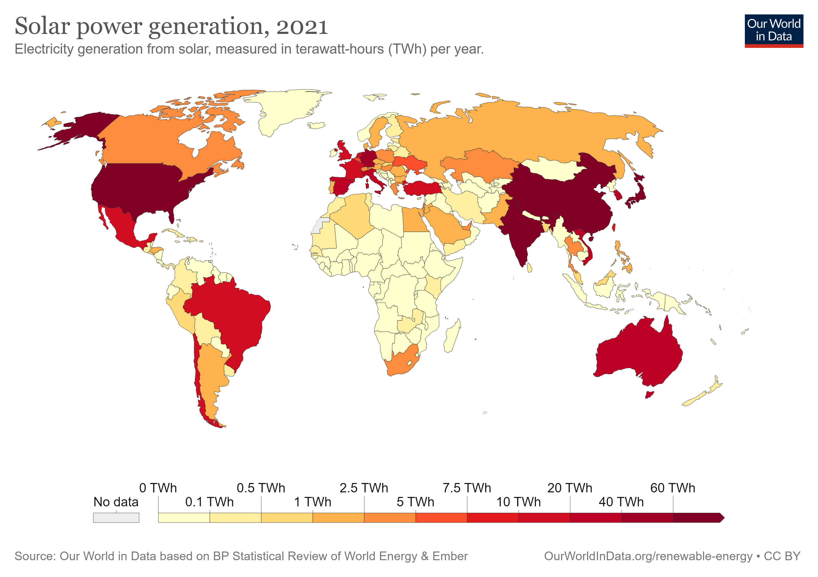
Solar power generation worldwide:

Slide 5
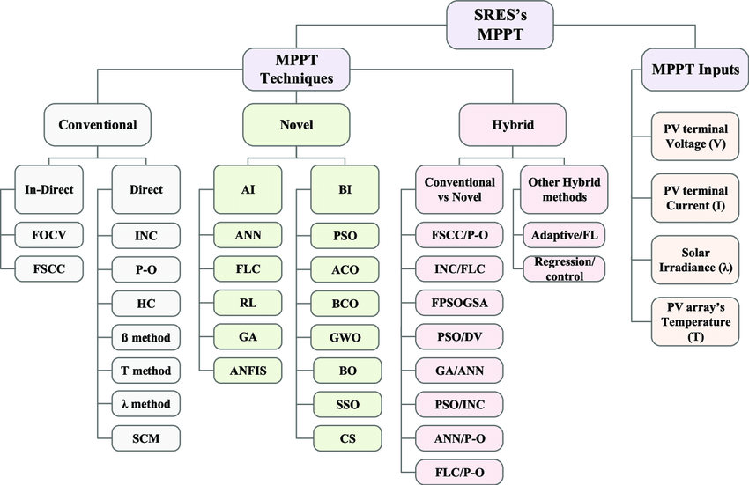
Why Fuzzy Logic MPPT?
Click here to add the text
Your text has been concise and beautiful, but the information is inextricably inextricable and needs to be expressed in more words; but please refine the essence of your thought as much as possible, otherwise it is easy to cause the reading pressure of the viewer, which is counterproductive.

Slide 6
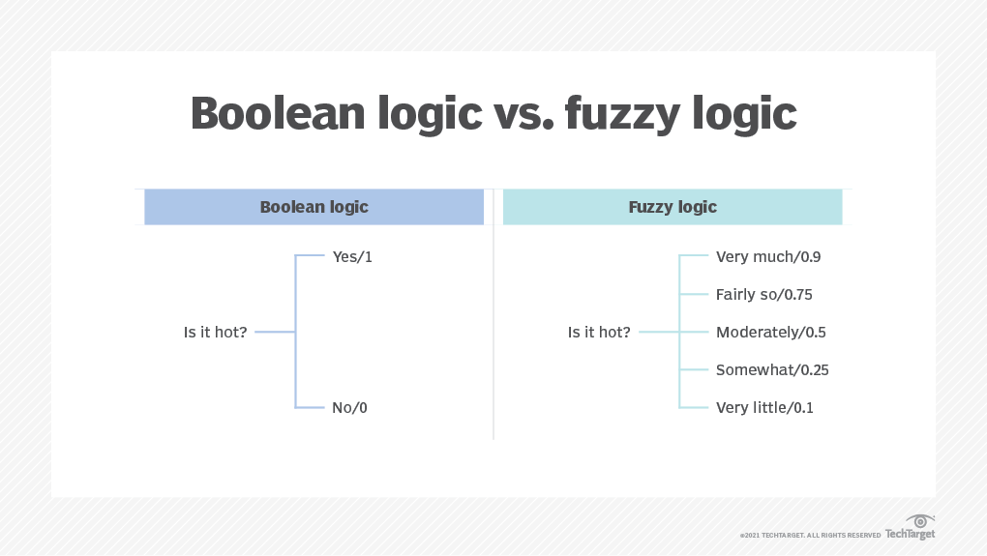
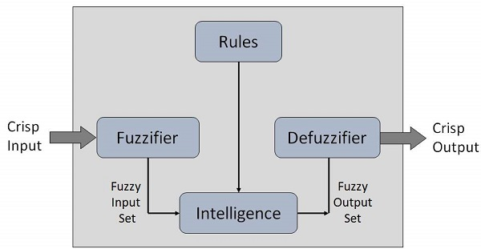
What is fuzzy logic?

Slide 7
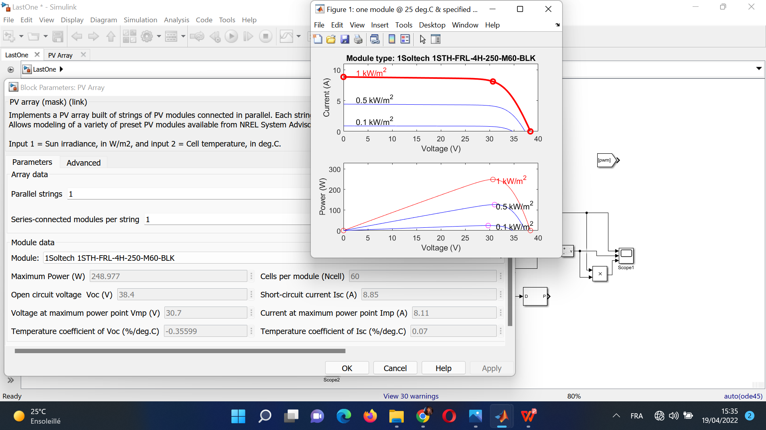
PV characteristics
Maximum power point graphs
VOC = 38.4 V
ISC= 8.85 Amp
VMP= 30.7 V
Maximum Power= 248.977 W
IMP= 8.11 Amp

Slide 8
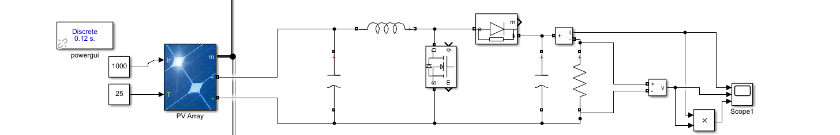
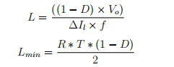
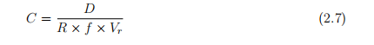
Boost Converter characteristics:
The advised MOSFET switching frequency, according to the literature, is fs= 50 Khz.
The load resistance is set at 10 Ω .
The converter operates in continuous conduction mode (CCM).
The minimal inductance calculated using the previous equation is: Lmin = 0.012 H .
The minimum value for the filter capacitance that results in a small voltage ripple is of
C = 0.012 µF .

Slide 9
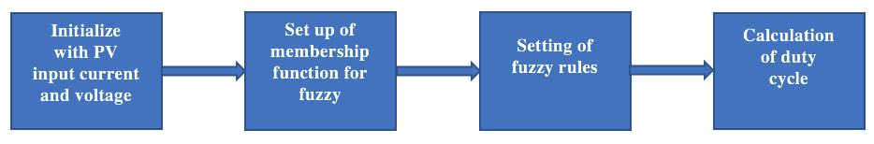

Design of Fuzzy Logic Controller Parameters:
Fuzzy control rules are extracted by analyzing the system behavior.
The different operating conditions are considered in order to improve tracking performance in terms of dynamic response and robustness.
The algorithm can be explained as follows:
-The initial duty cycle, D= 0.
-The converter input current Im, and voltage Vm sense the duty cycle resulting in maximum power at that time based on predicted values in the fuzzy system.
-This operation is repeated until the system is both stable and at maximum power.

Slide 10
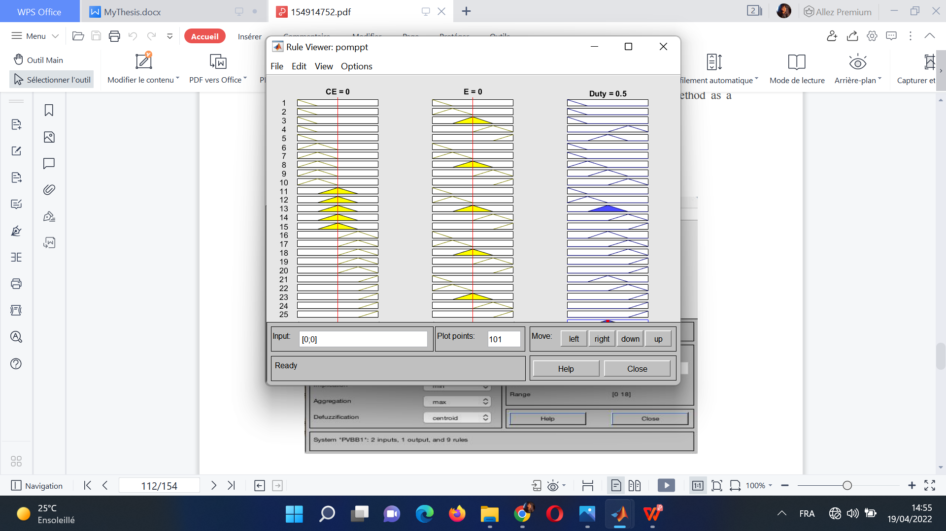
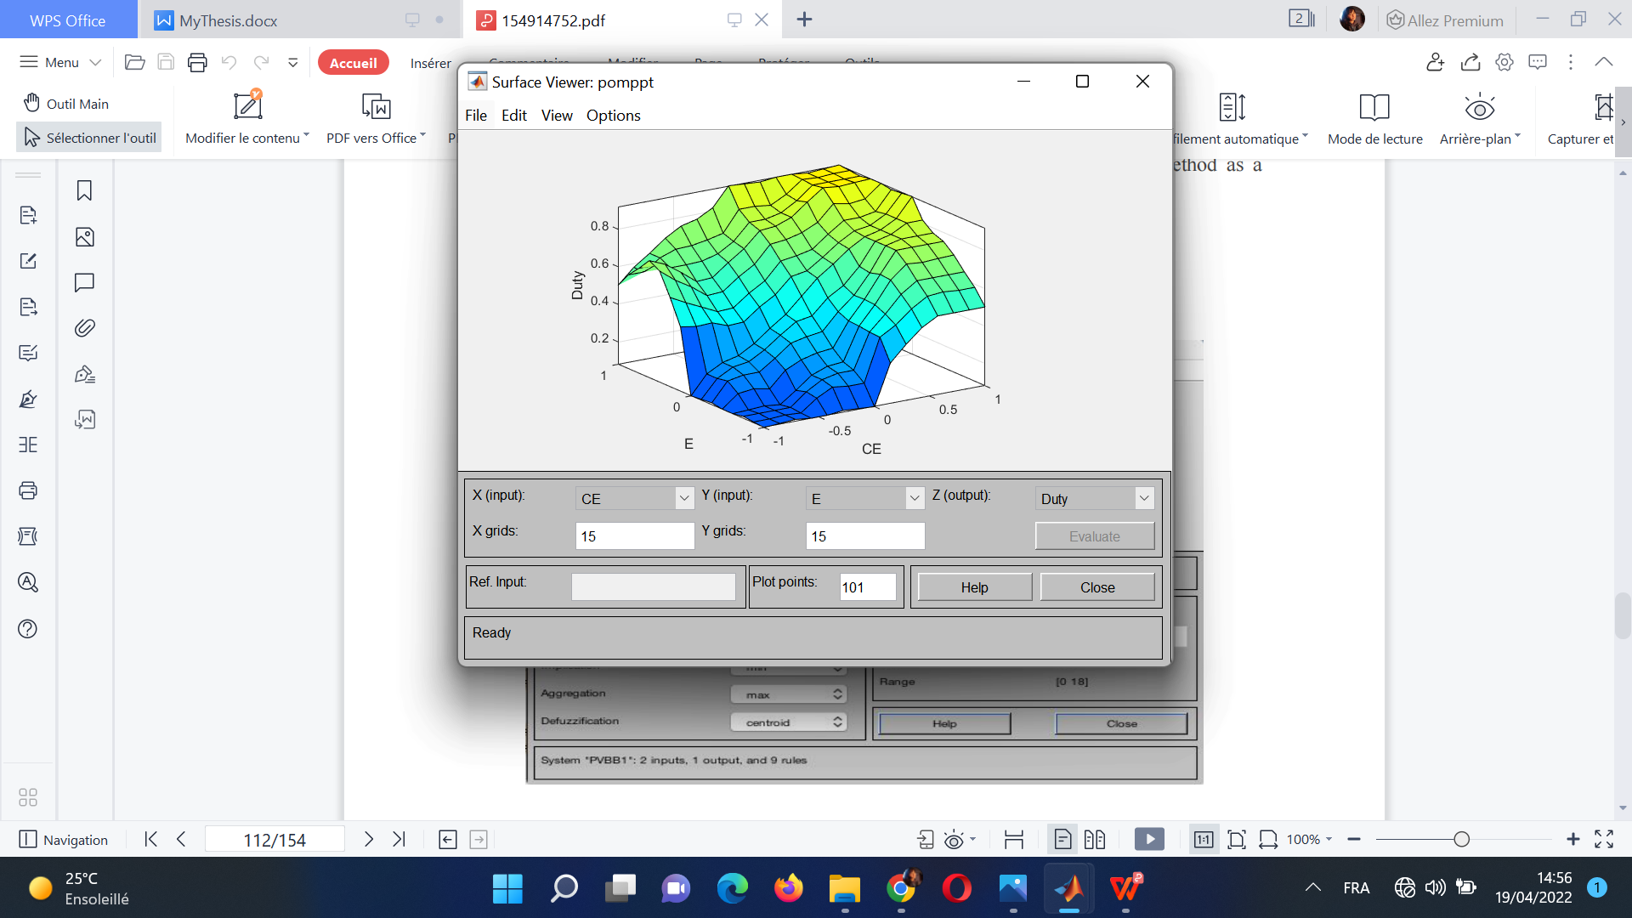
Tuning of Control Rules:

Slide 11
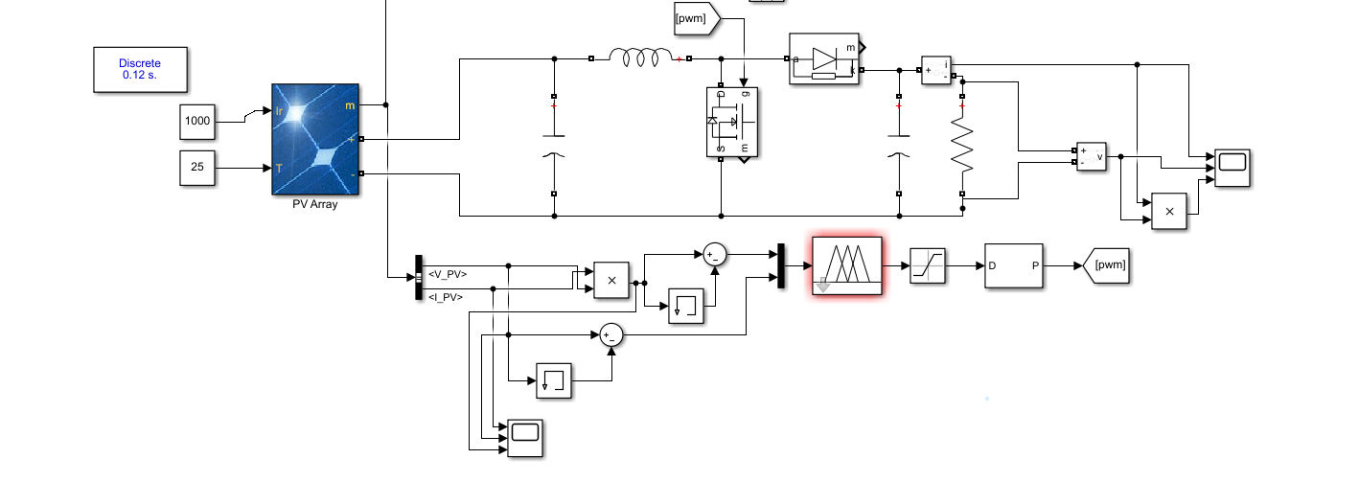
Fuzzy logic based maximum power point tracking of photovoltaic system:

Slide 12
The Fuzzy logic controller is connected to the Mppt controller’s algorithm.
The input to the fuzzy block is given from the input signal block which is the signal of change in voltage and power to the fuzzy logic controller.
The output of the Fuzzy logic Mppt controller serves as the gate pulse to the DC to DC boost converter.
The fuzzy logic controller contains the stored MPPT file which contains the rules and membership functions to obtain the maximum output voltage from the solar PV module.
The output of the fuzzy logic controller depends on the stored membership function and rule evaluation.

Slide 13
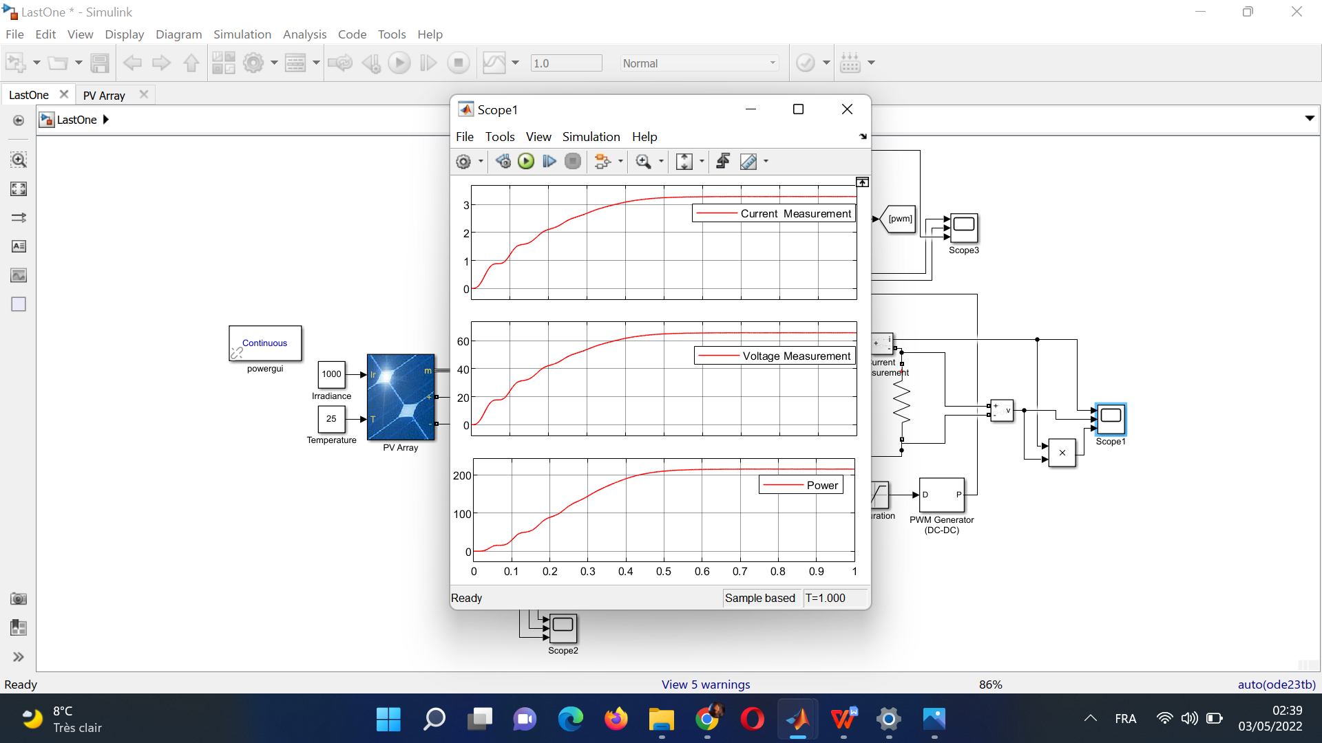
Current, voltage and power output graphs for 1kw/m² irradiance.
 | Input power (W) | Output power(W) | Duty cycle | Efficiency %
1000 | 248,977 | 245 | 0,71 | 0,9840266
800 | 200,899 | 197,2 | 0,70 | 0,9815877
500 | 126,347 | 120,4 | 0,65 | 0,9529312
100 | 24,254 | 22,3 | 0,39 | 0,9194359

Slide 14
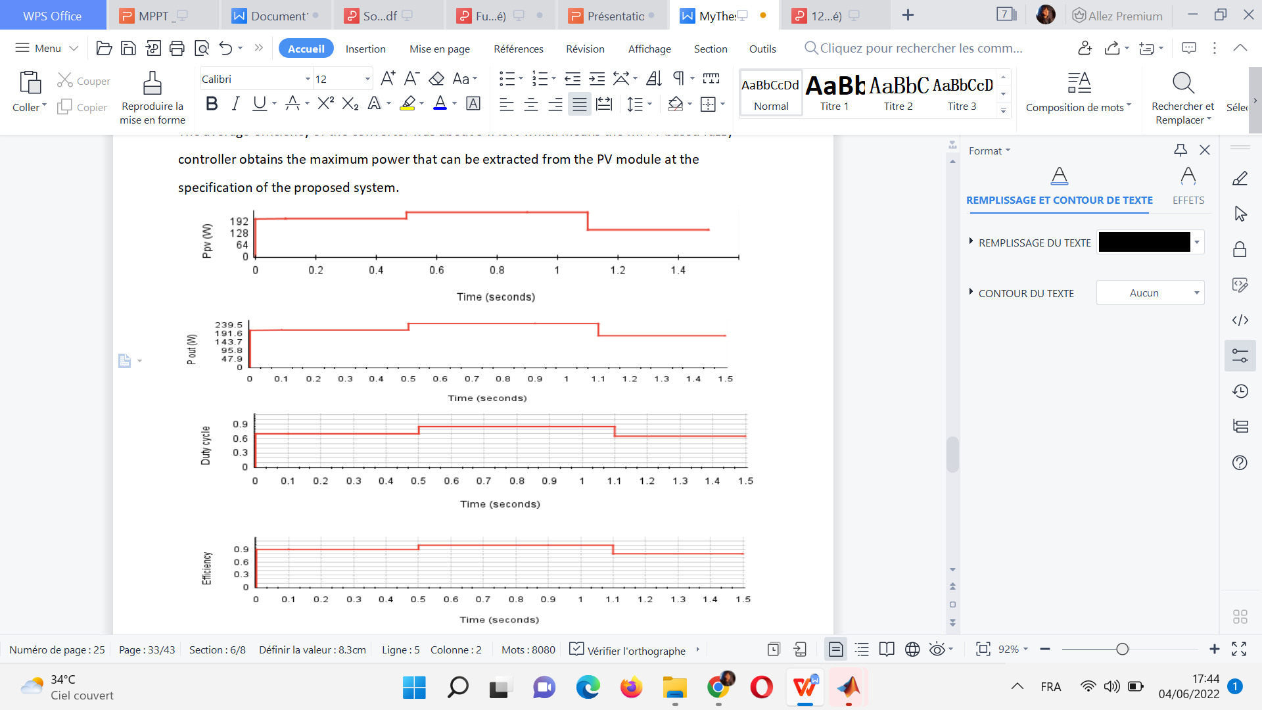
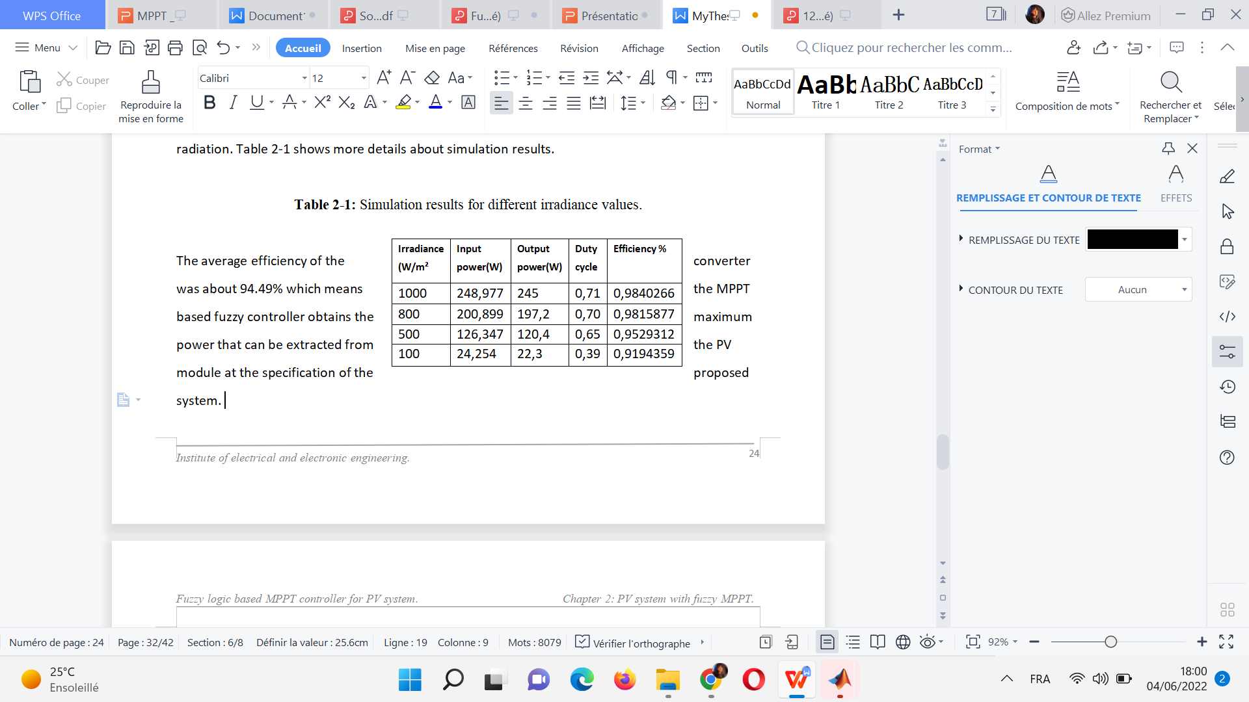
MATLAB Simulation & results:
The average efficiency of the converter was about 94.49% which means the MPPT based fuzzy controller obtains the maximum power that can be extracted from the PV module at the specification of the proposed system.
 | Input power (W) | Output power(W) | Duty cycle | Efficiency %
1000 | 248,977 | 245 | 0,71 | 0,9840266
800 | 200,899 | 197,2 | 0,70 | 0,9815877
500 | 126,347 | 120,4 | 0,65 | 0,9529312
100 | 24,254 | 22,3 | 0,39 | 0,9194359

Slide 15
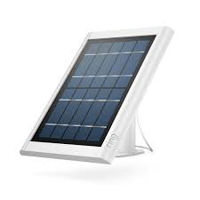
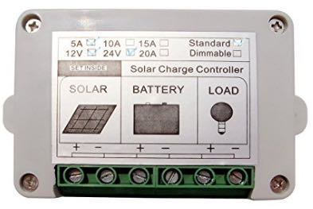
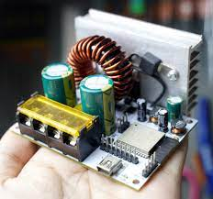
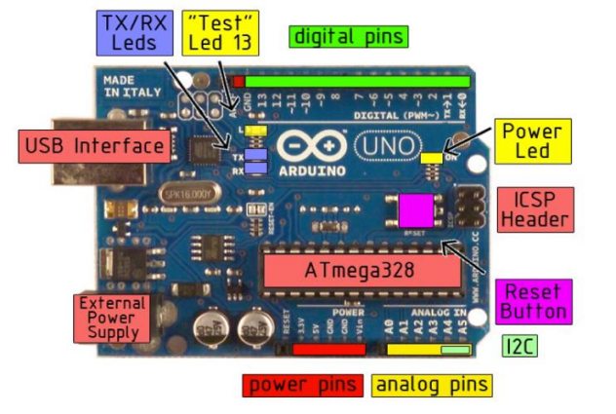
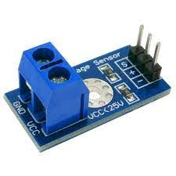
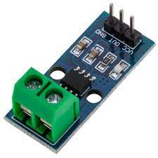
Hardware Implementation:
15A ECO-WORTHY solar charge regulator
Inside components of the MPPT charge controller
PV Panel
Voltage sensor
Current sensor
Arduino Uno board pins.

Slide 16
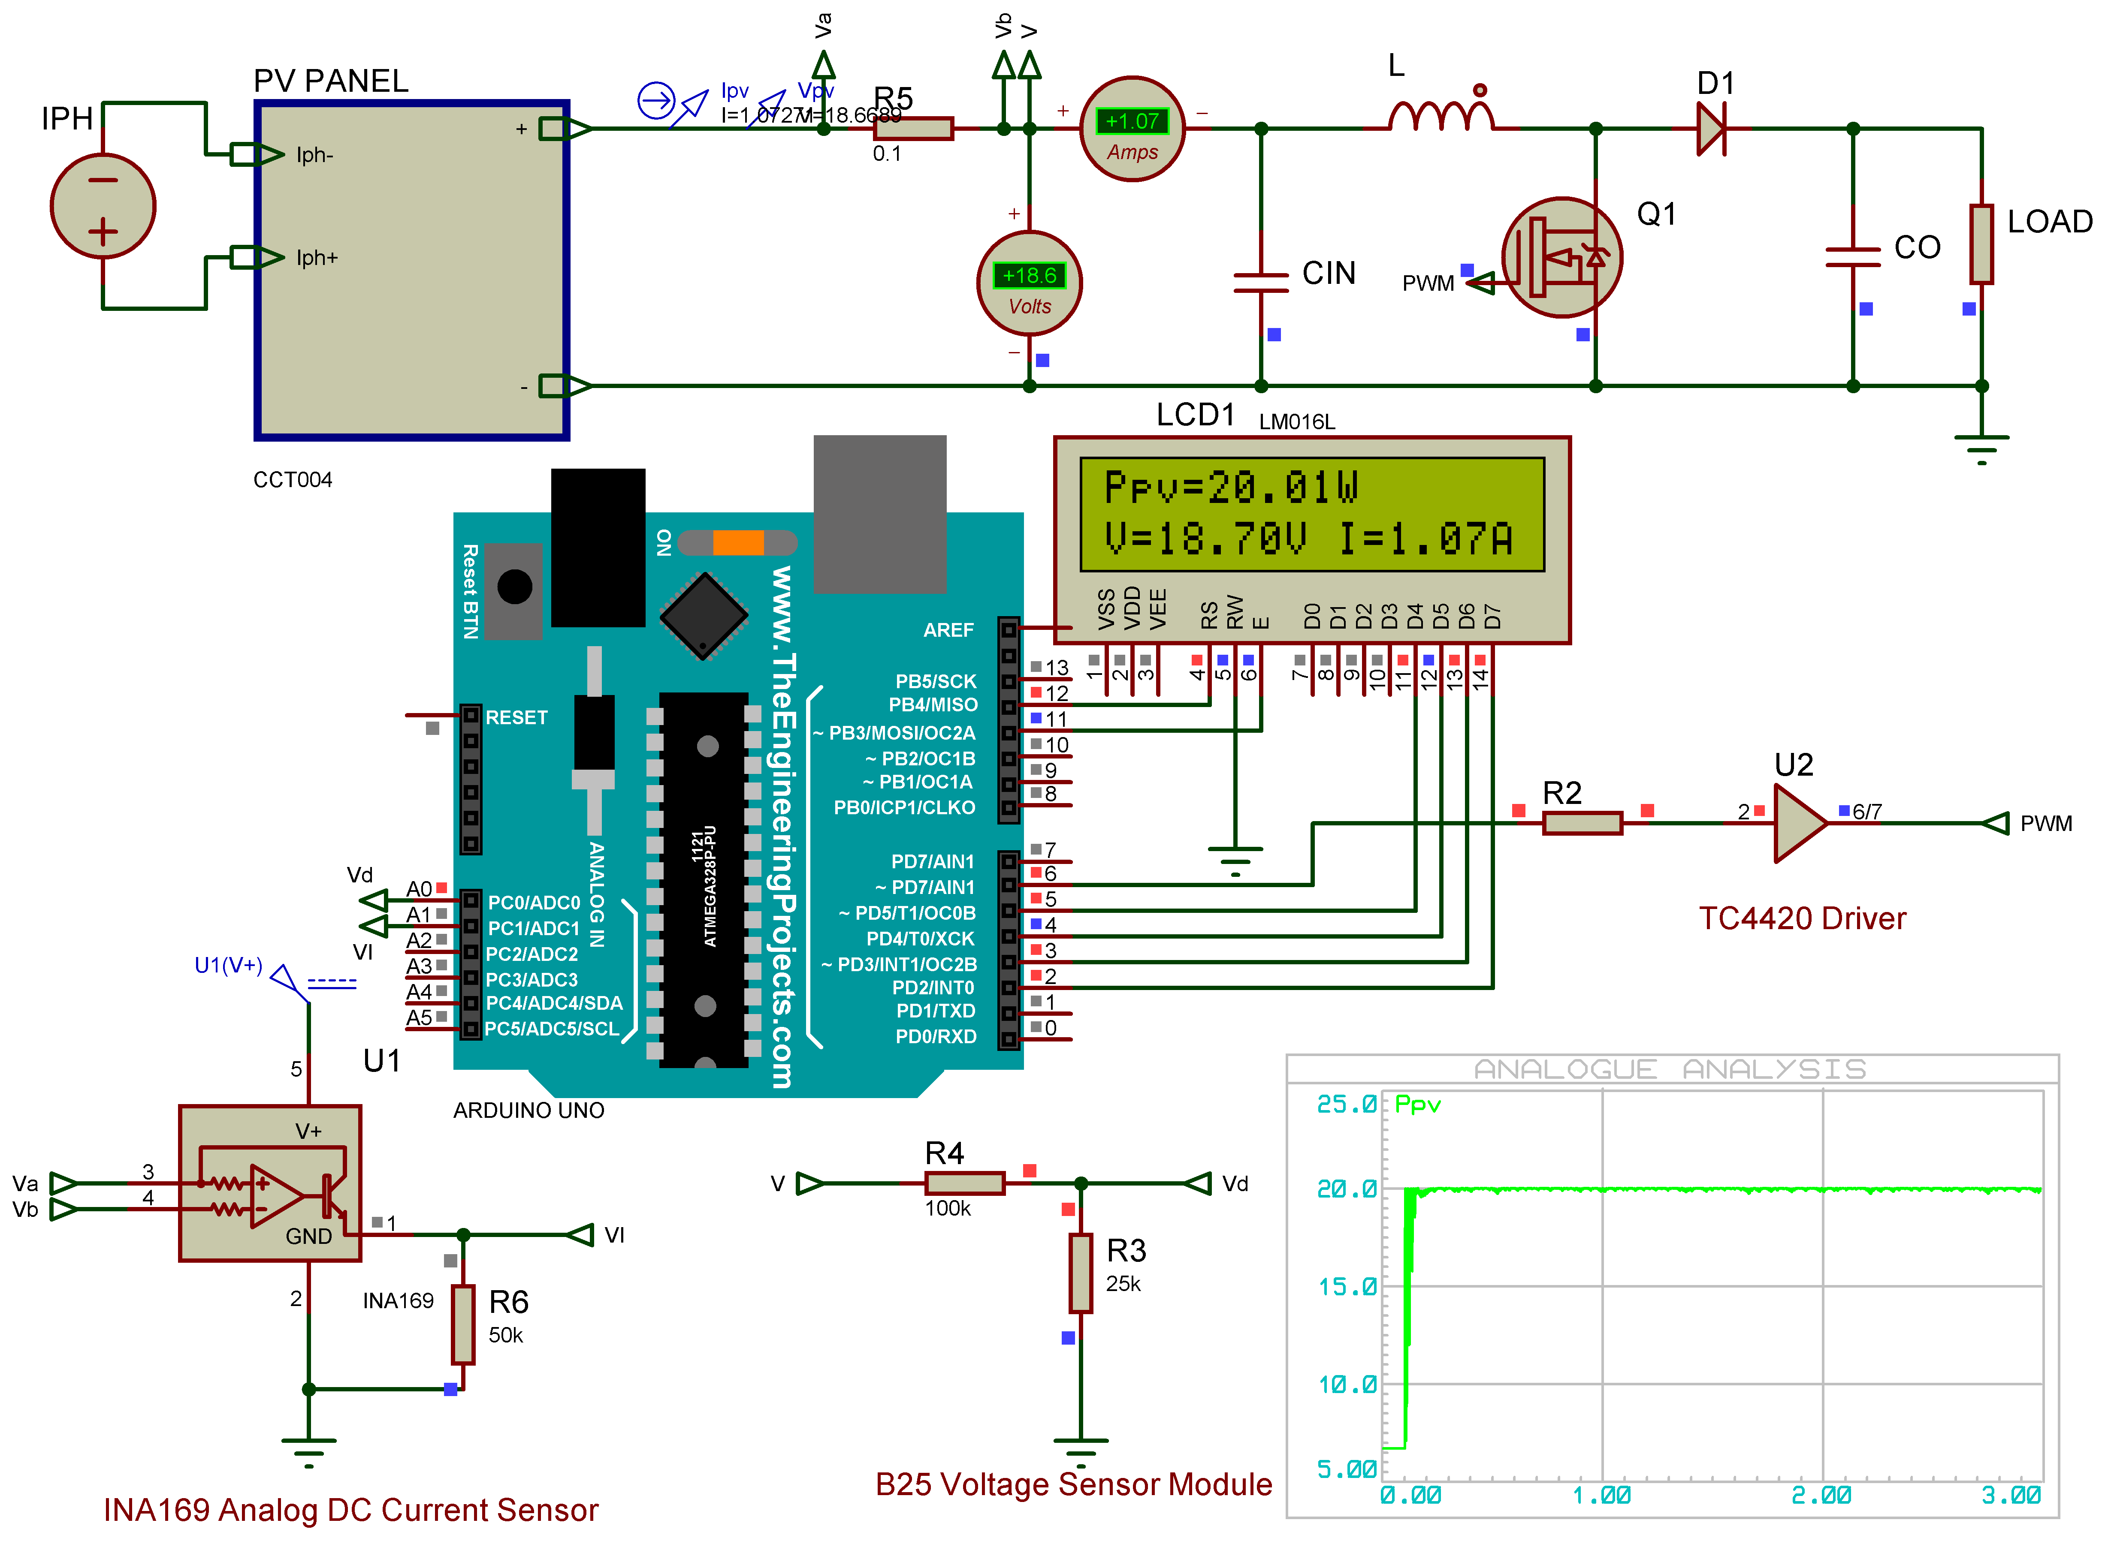
MPPT Under Arduino Uno with LCD and Driver using Proteus:

Slide 17

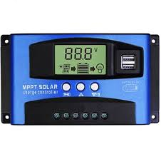
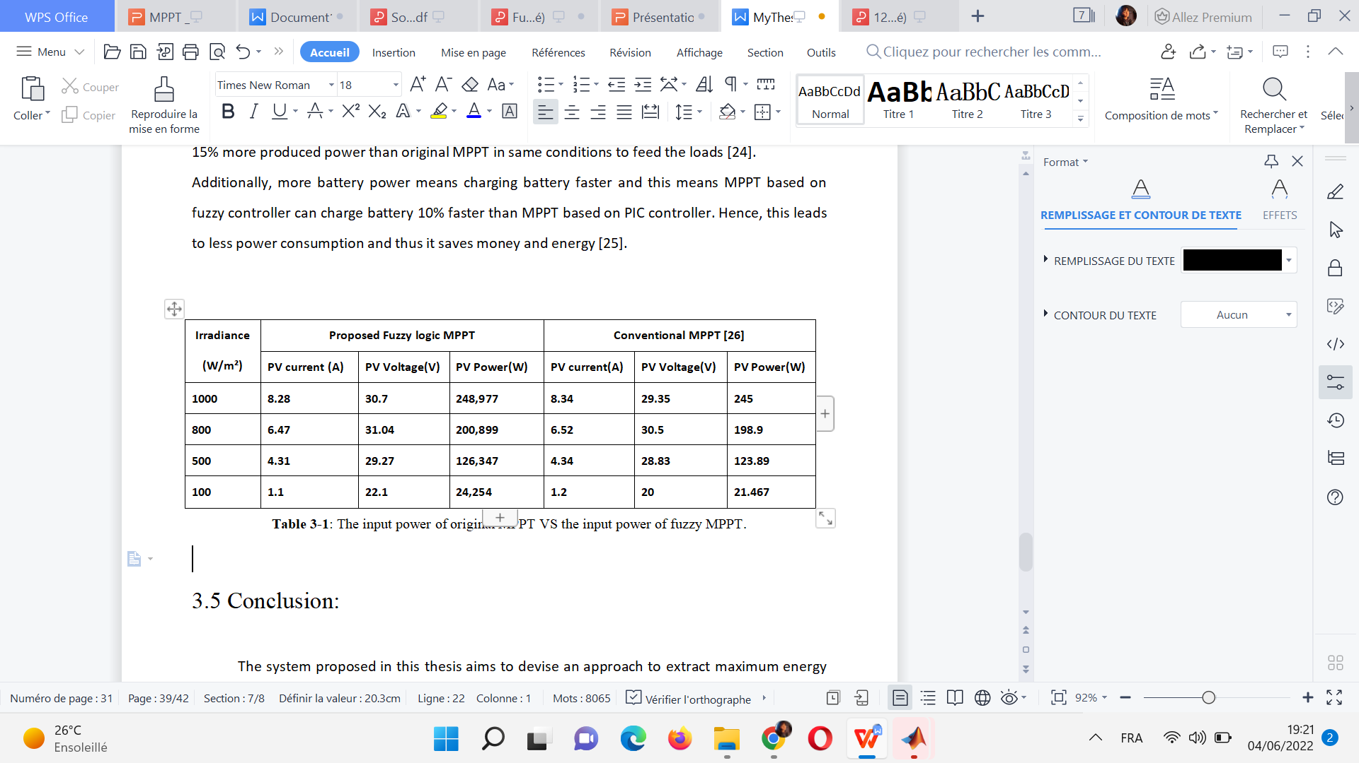
Conventional MPPT VS Fuzzy controlled MPPT:
We conclude that the MPPT based fuzzy controller extracts the power that feeds about 248.977 W/h whilst the original MPPT produces about 245 W/h. This means the fuzzy controller added about 10% more produced power than original MPPT in same conditions to feed the loads.
Additionally, more battery power means charging battery faster and this means MPPT based on fuzzy controller can charge battery 10% faster than original MPPT controller. Hence, this leads to less power consumption and thus it saves money and energy.

Slide 18
Conclusion:
The proposed approach was to use a fuzzy logic-based algorithm for tracking optimal power.
Compared to other MPPT, the fuzzy controller offers improved performance with regard to MPP oscillations and sensitivity to parameter changes.
A considerable amount of additional energy can be extracted from a PV module by applying a fuzzy logic-based MPPT compared to conventional MPPT.
These findings point to a potentially improved efficiency and robustness in the PV system, as loads and batteries can then be charged and used even during low solar radiation periods.

Slide 19
Thank you for your attention!
Any questions?

